Slide 1
Transactions
Module - 15

Slide 2
Contents
Overview

Slide 3
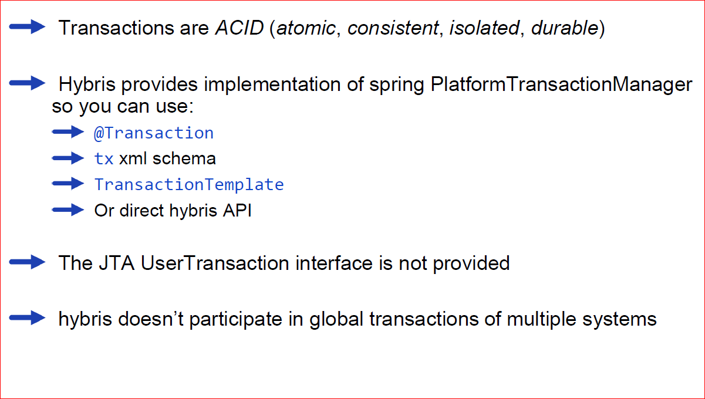
Transactions

Slide 4
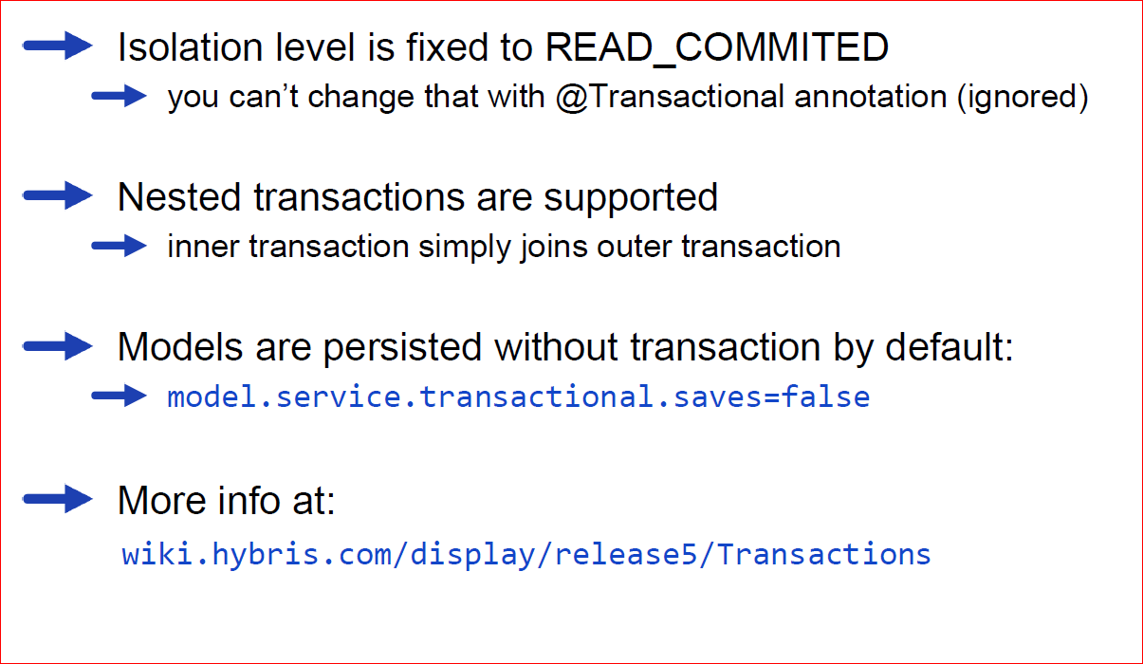
Transactions isolation

Slide 5
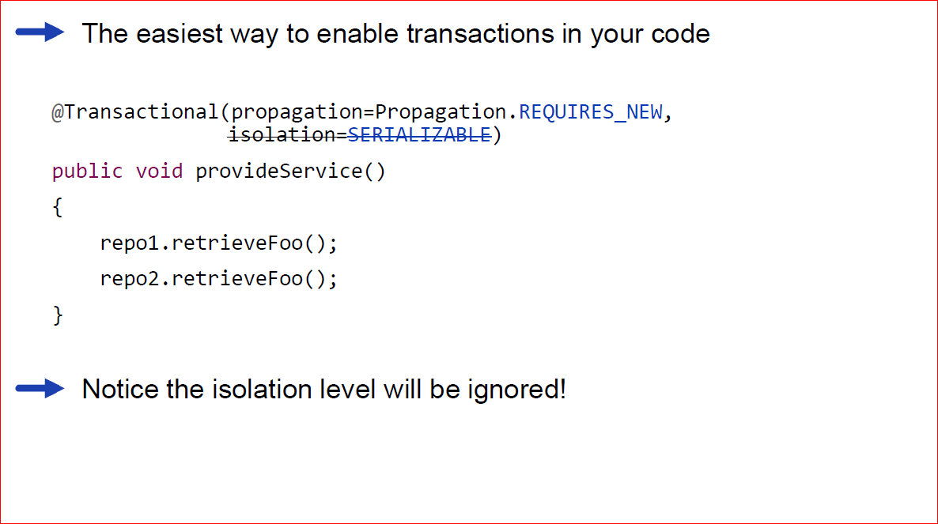
Annotation example

